Slide 1
Office 365 Development
July 2014

Slide 2
Course Agenda
Introduction to Office 365 Development
Module 1: Overview of Office 365 Development
Module 2: Getting started with Apps for Office
Module 3: Getting started with Apps for SharePoint
Module 4: Getting started with the Office 365 APIs
Module 5: Getting started with Mobile development with Office 365
Module 6: Moving Full Trust Code to the Cloud Using Repeatable Patterns and Best Practices
Module 7: Setting up your Developer environment in Office 365
Module 8: Setting up your on-premises environment for app development

Slide 3
Getting started with Mobile development with Office 365
Jeremy Thake
Technical Product Manager, Microsoft
Scot Hillier
SharePoint MVP, Scot Hillier Technical Solutions, LLC

Slide 4

Agenda
Intro
Windows Platform
Non-windows Platforms
Multi-platforms

Slide 5
Intro
Getting started with Mobile development with Office 365

Slide 6
Choices for Mobile Development
Target the Windows Platform
Develop apps that run in Windows and Windows Phone
Target the Android Platform
Develop apps that run on Android devices
Target the iOS Platform
Develop apps that run on iOS devices such as iPhone and iPad
Target Multiple Platforms
Develop apps which can be targeted for more than one platform
Use Cordova to develop apps which target Android, iOS and Windows Phone
Use Xamarin to develop apps which target Android, iOS and Windows Phone

Slide 7
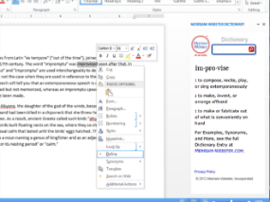
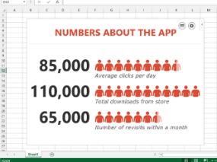
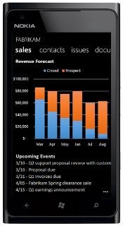
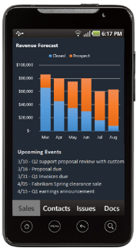
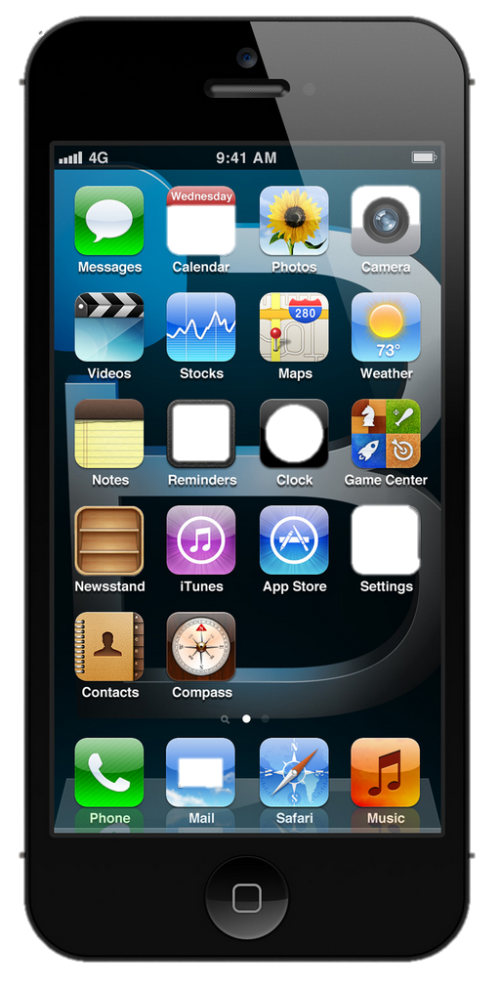
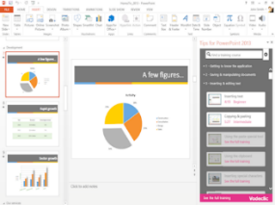
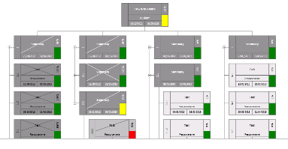


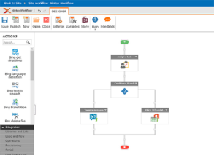



The new Office development platform
Contextual apps
Robust APIs
Flexible tools
iOS
Documents
Search
Mail
Social
Calendar
People
Notes:
Two kinds of apps :
you light up Office/Exchange/SharePoint.
You consume our services in a custom (device or web) app
Contextual apps
Rich, powerful interactive IW experiences
Do more, without leaving Excel, Outlook, PowerPoint, SharePoint
Consistent Framework everywhere that Office runs. Everywhere that people do work
Robust APIs
Big news
More for SharePoint Devs
Growing up outside SharePoint
Flexible Tools
Open-ness and choice is a core pillar
But … we just want to take away all the friction
Tools targeted to specific users
Platforms with best management, capability and scale
What does this mean. Where is the value
Breadth : more endpoints and experiences
Depth: richer APIs. More capabilities
Power:

Slide 8
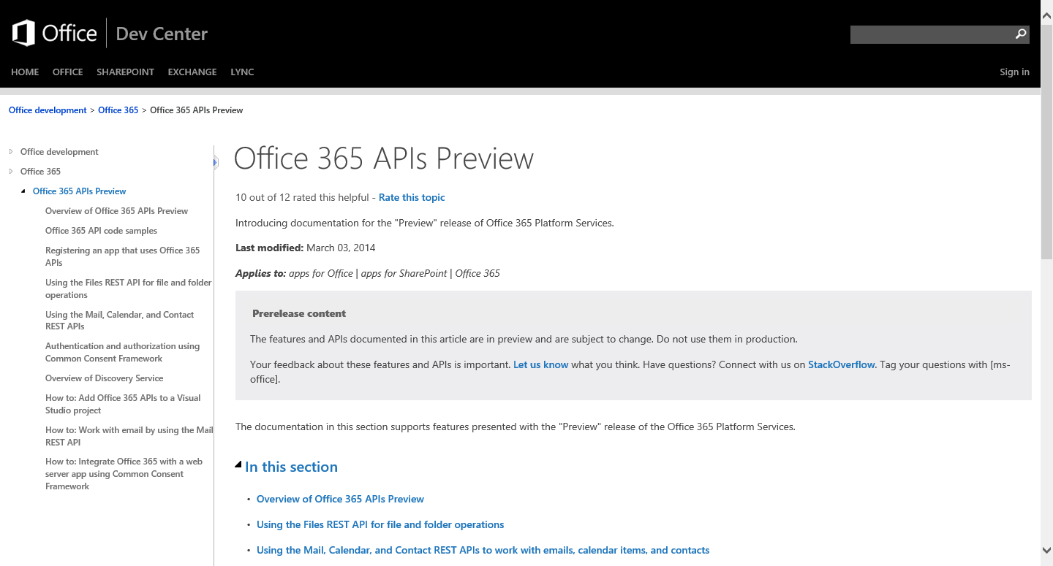
http://aka.ms/Office365DevAPIs

Slide 9
Windows Platform
Getting started with Mobile development with Office 365

Slide 10
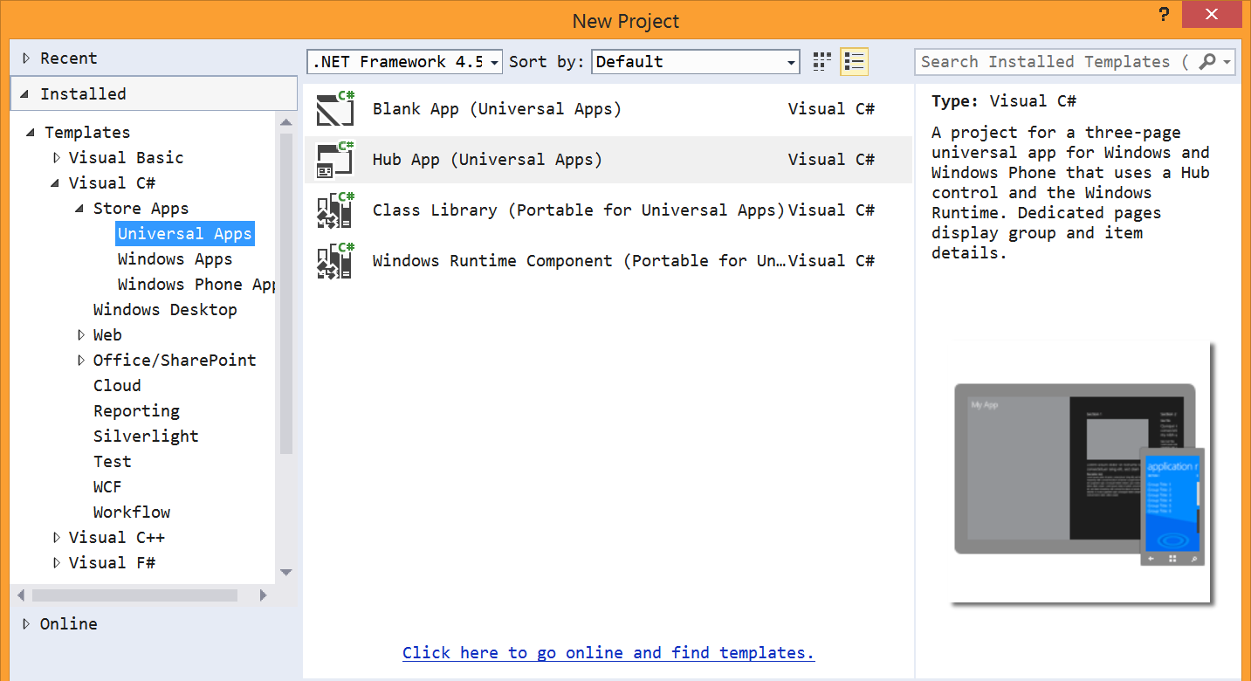
Universal App project template

Slide 11
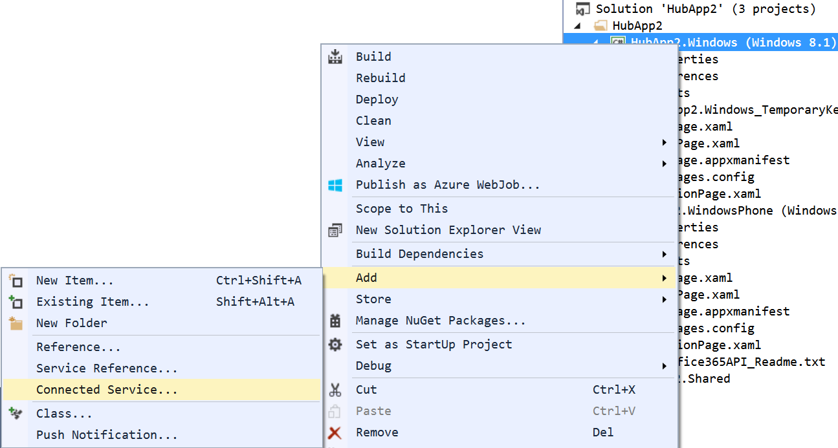
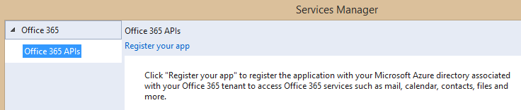
Adding Connected Services
1
Project > Add > Connected Service…
2
Register your app

Slide 12
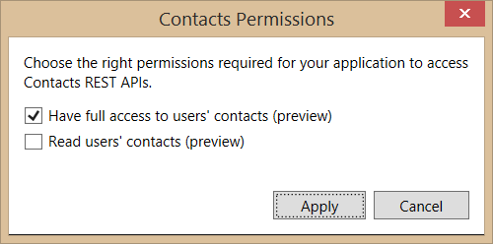
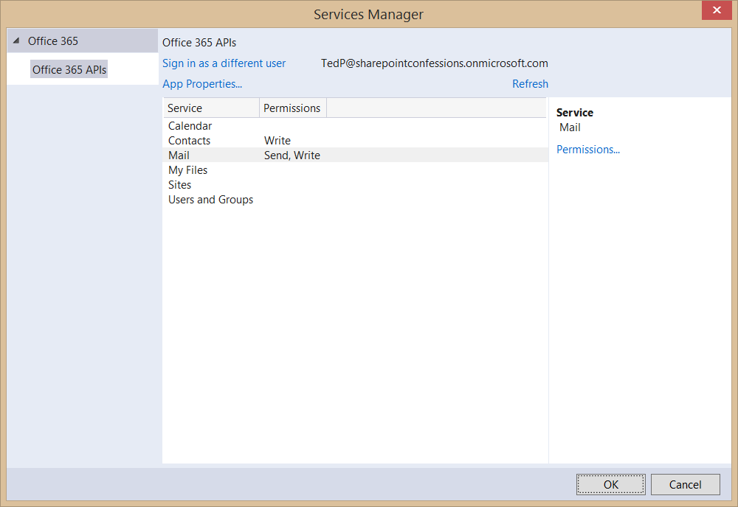
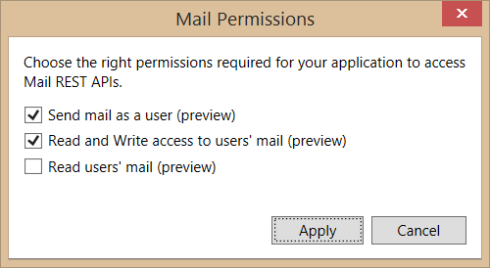
Connected Services Permissions
3
Select required app permissions

Slide 13
“Client” object constructor example
return new ExchangeClient(ExchangeServiceEndpointUri, async () =>
{
return (await _discoveryContext.AuthenticationContext
.AcquireTokenSilentAsync(
ExchangeServiceResourceId,
_discoveryContext.AppIdentity.ClientId,
new ActiveDirectory.UserIdentifier(
dcr.UserId,
UserIdentifierType.UniqueId)
)
).AccessToken;
});

Slide 14
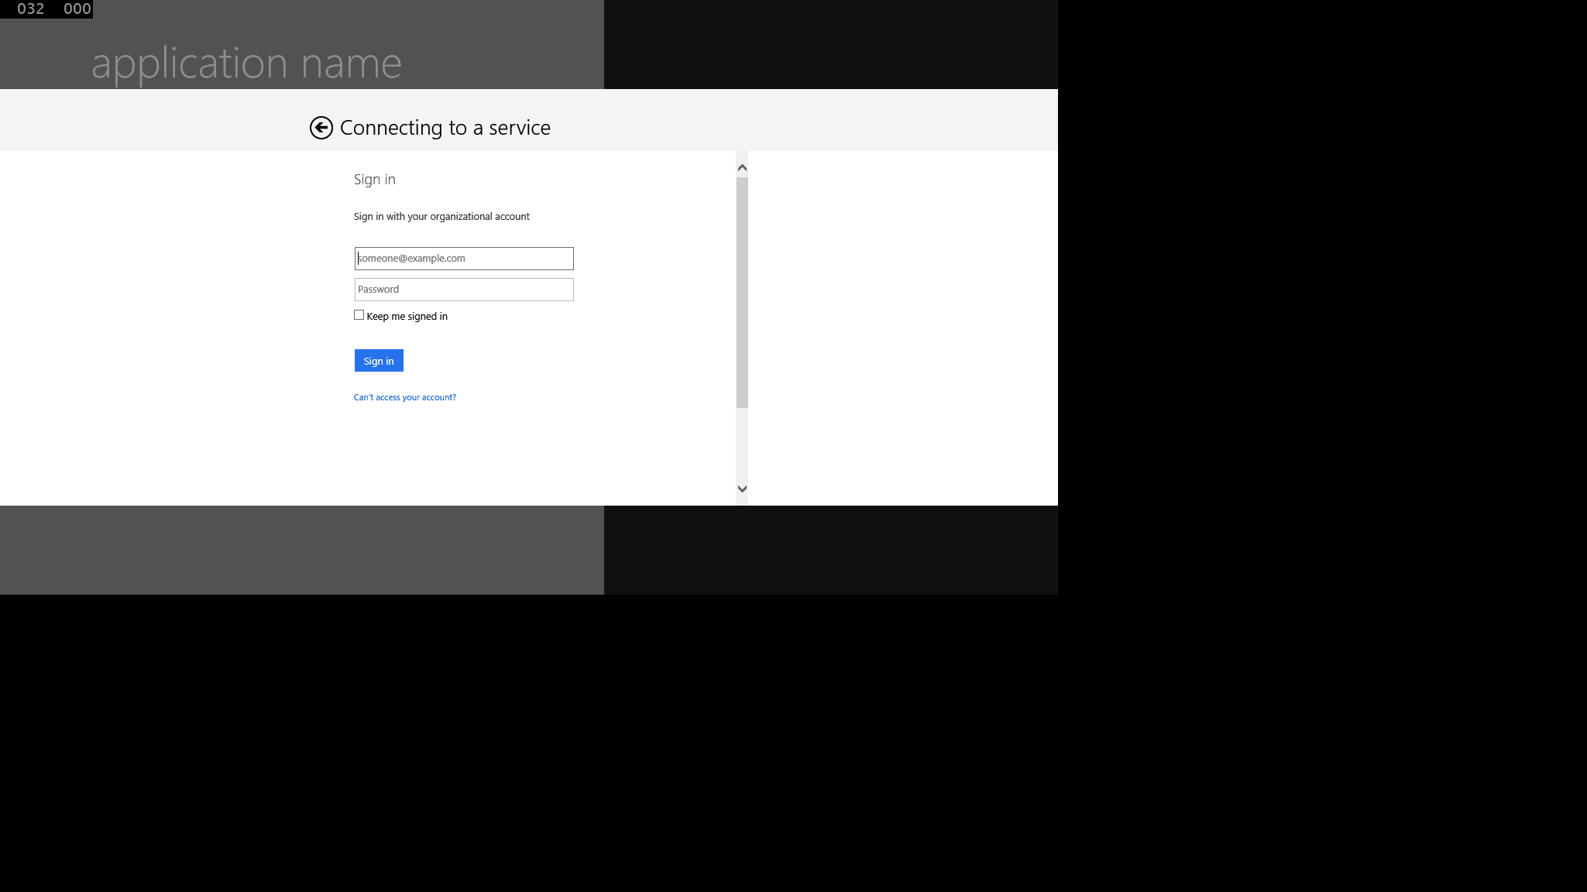
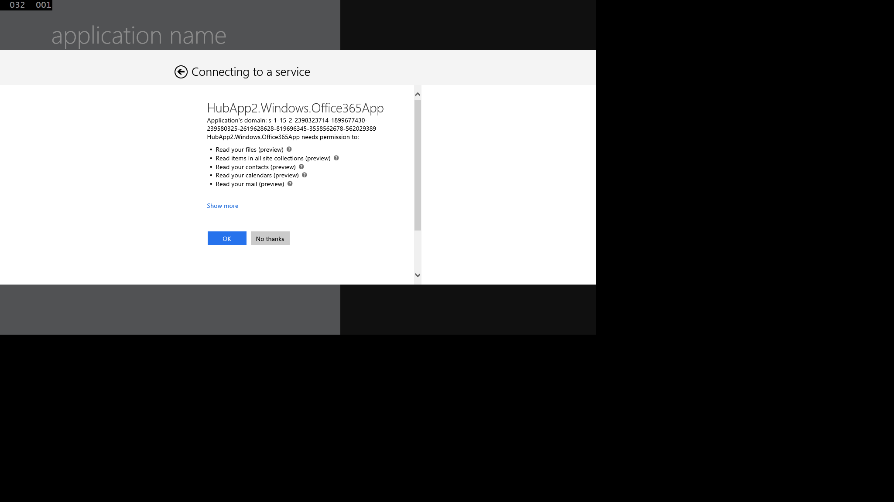
Authentication UI

Slide 15
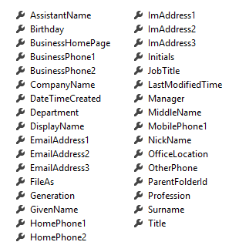
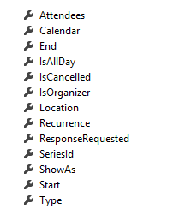
Office 365 Service Communication
Client Object exposes properties
Most are IEnumerable<T> collections
Designed much like Entity Framework
Client == DataContext
IEnumerable<T> entities
Includes common CRUD operations
Contact
Event

Slide 16
demo
WINDOWs 8

Slide 17
Native Platforms
Getting started with Mobile development with Office 365

Slide 18
Getting Started with the Android SDK

Slide 19
The New Android Platform IDE

Slide 20
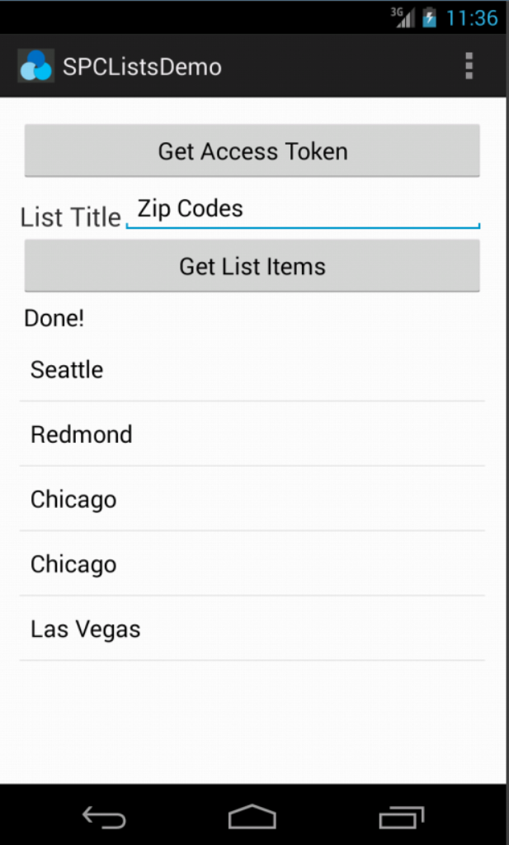
Office 365 SDK for Android
Available today on GitHub
SDK for native Android apps that use Office 365 APIs
Handles files, lists, mail, and calendar
Integrates with AD authentication library

Slide 21
demo
ANDROID

Slide 22
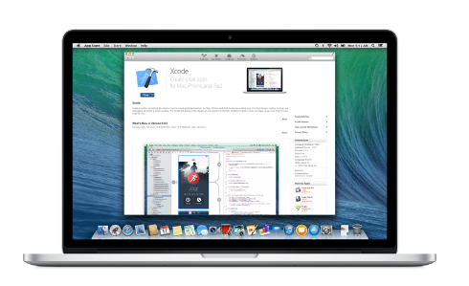
Developing for iOS
Developing for iOS requires a Mac (or something running iOS)
Apple does not permit compilation of iOS apps on a non-iOS computer or device
You either need (1) a Mac or (2) a Windows PC that’s paired with a Mac nearby
Developing iOS apps
The primary programming language is Objective C
Many developers use the XCode IDE provided by Apple
XCode also installs iOS SDK

Slide 23
Office 365 SDK for iOS

Slide 24
demo
iOS

Slide 25
Multi-platform
Getting started with Mobile development with Office 365

Slide 26
What is a Hybrid App?
An app created with HTML5, CSS3 and JavaScript
Available through an app store
Different than a mobile web site
Hybrid app runs in browser of mobile device
Chromeless (no browser title bar, navigation buttons, etc.)
HTML, CSS and JavaScript downloaded and run locally from device
App launched in full screen mode
User isn’t aware that app is using browser

Slide 27
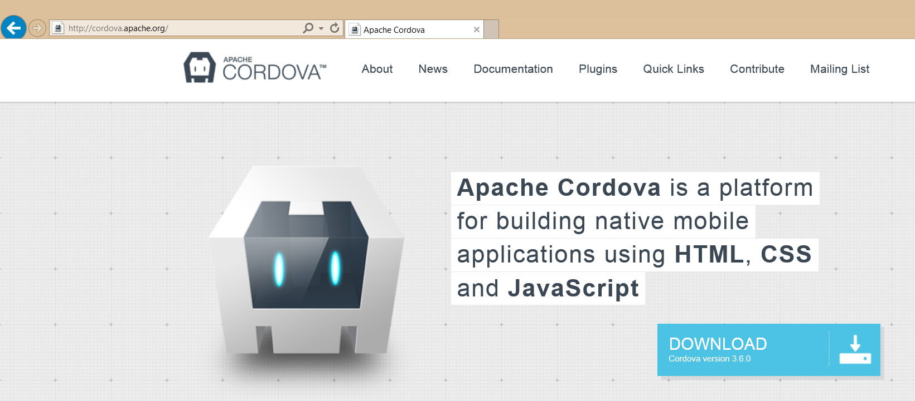
What is Cordova?
A platform for developing hybrid apps with HTML, CSS and JavaScript
An open source collection of JavaScript device APIs
Something that abstracts away device specific APIs
Toolsets built on top of Cordova
PhoneGap (Abode)
AppBuilder (Telerik)

Slide 28
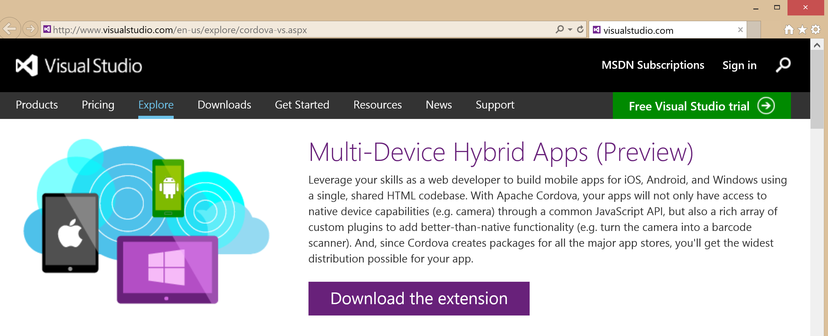
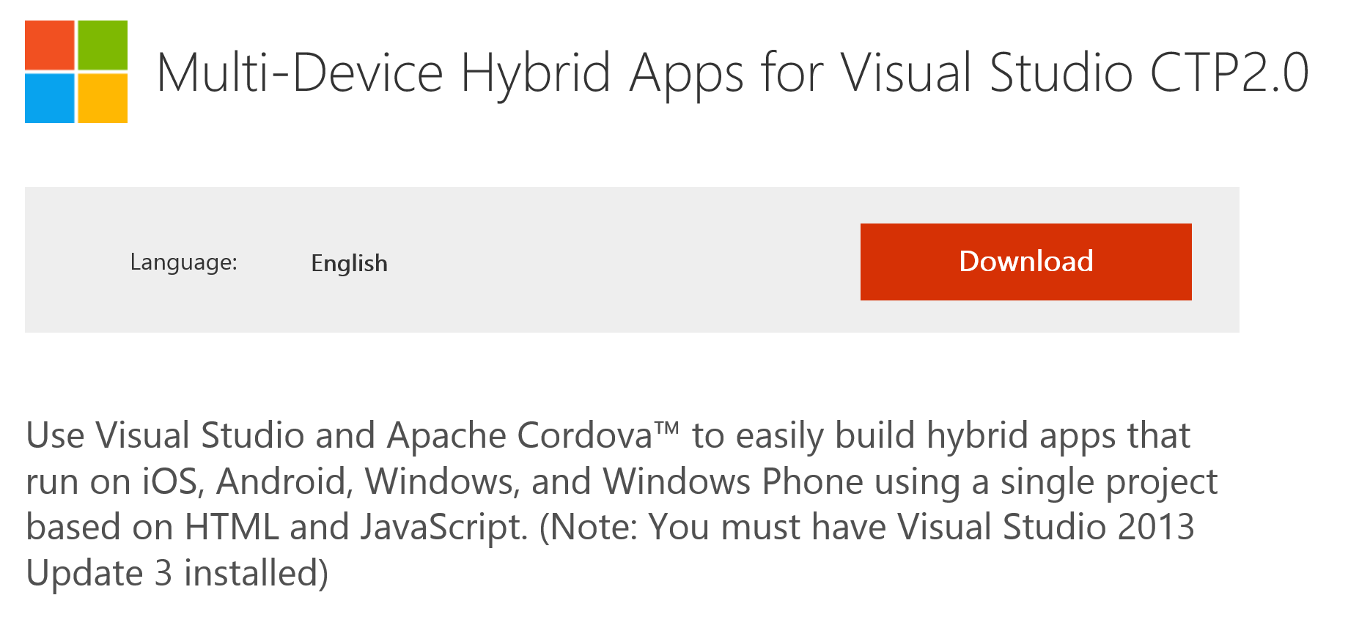
Multi-Device Hybrid Apps for Visual Studio

Slide 29
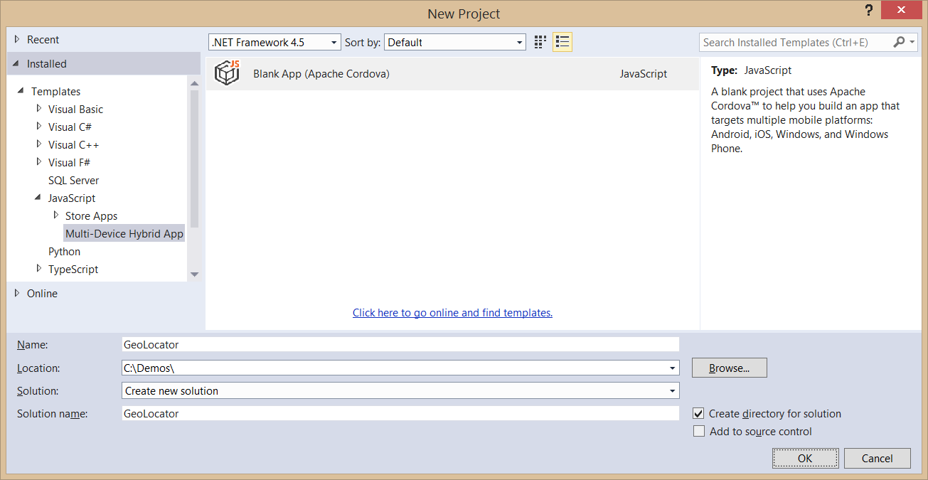
Creating a Cordova App
Use the Blank App (Apache Cordova) template
Templates > JavaScript > Multi-Device Hybrid Apps

Slide 30
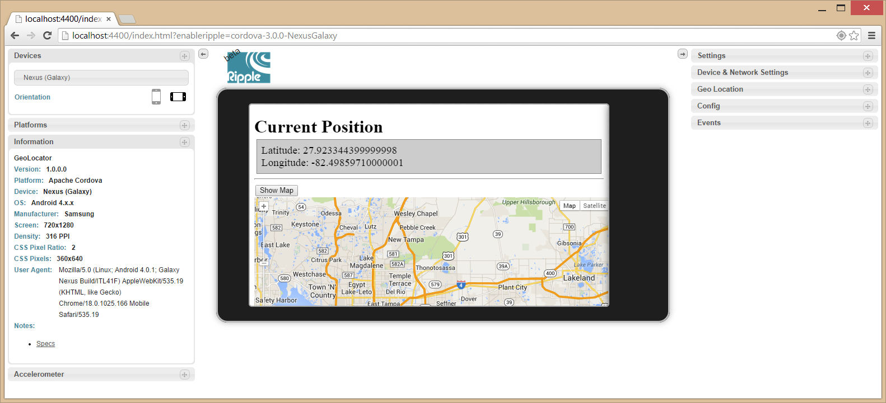
Debugging with Ripple
Included with Android SDK
Runs inside Chrome browser

Slide 31
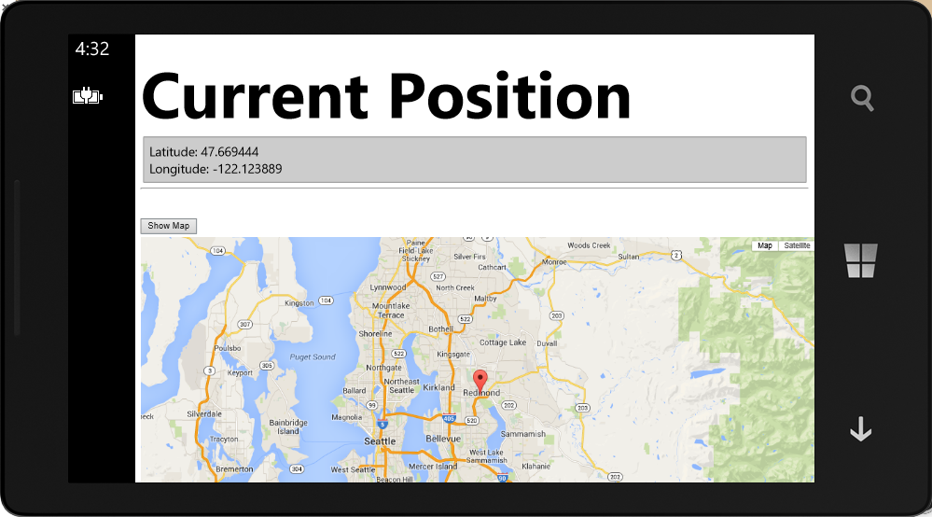
Debugging with Windows Phone
You can use a Windows Phone emulator
You can use an attached Windows Phone device

Slide 32
demo
Cordova

Slide 33
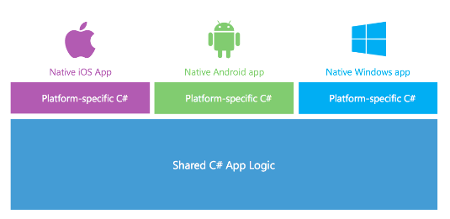
What is Xamarin?
A Company and a Development Platform
Developing on Xamarin platform requires monthly or yearly subscription
You can get a free 30-day trial (90-day trial available for MSDN subscribers)
Xamarin Development based on the .NET framework
You write code using C# and the .NET framework class libraries
Xamarin Platform supported across many OSs and devices
Android
iOS and Mac
Windows and Windows Phone

Slide 34
Evolution of the Xamarin Platform
Xamarin Platform’s Key Value Proposition
Provide update-to-date versions of .NET on Xamarin.iOS and Xamarin.Android
Allow you to leverage skills you already have with Visual Studio, C# and .NET
Support latest C# features such as support for async and await
iOS
iOS
MonoTouch
Xamarin.iOS
Linux
Mono
CLR & .NET
Android
Android
Mono for Android
Xamarin.Android

Slide 35
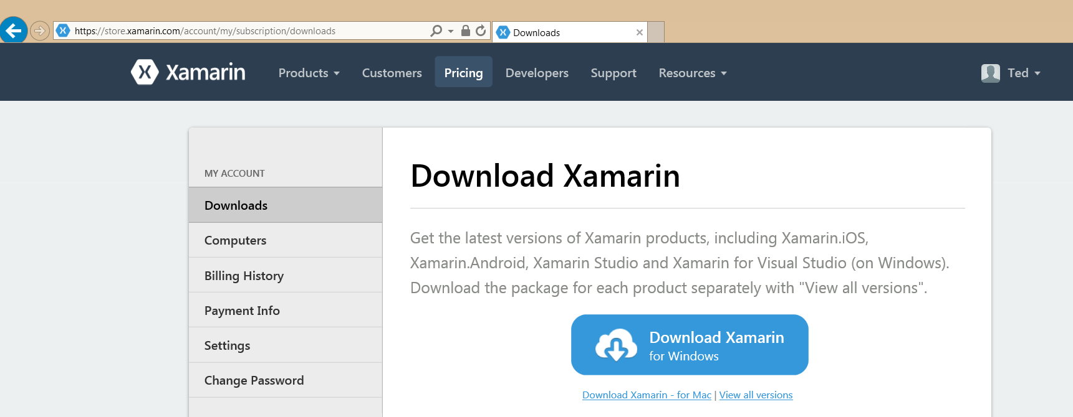
Xamarin Setup
Visual Studio 2013 with Update 3
Install Xamarin

Slide 36
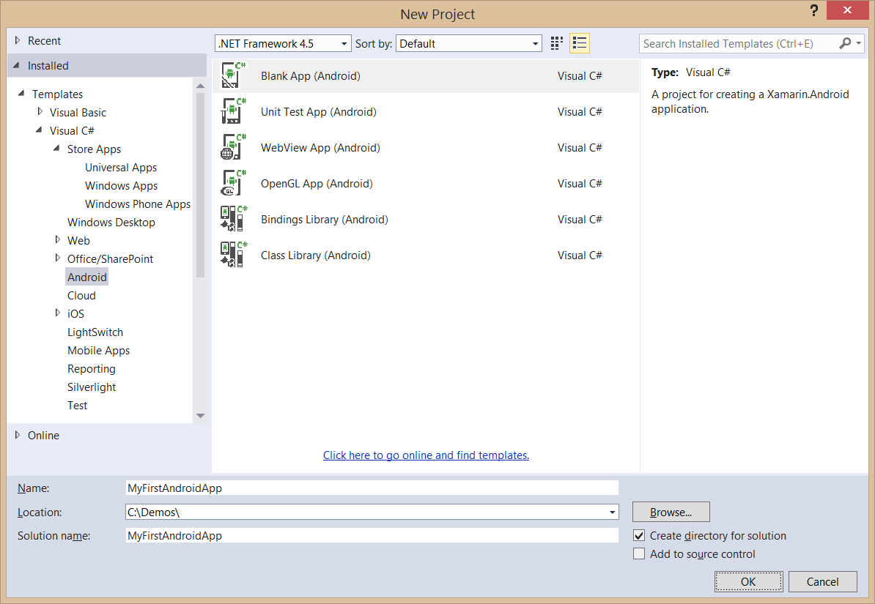
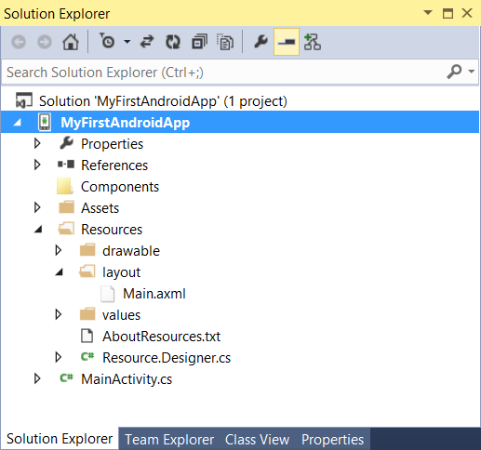
Creating an Android App Project

Slide 37
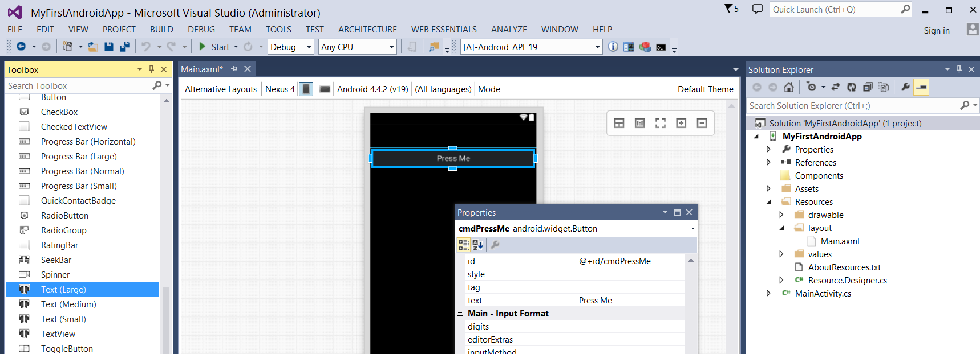
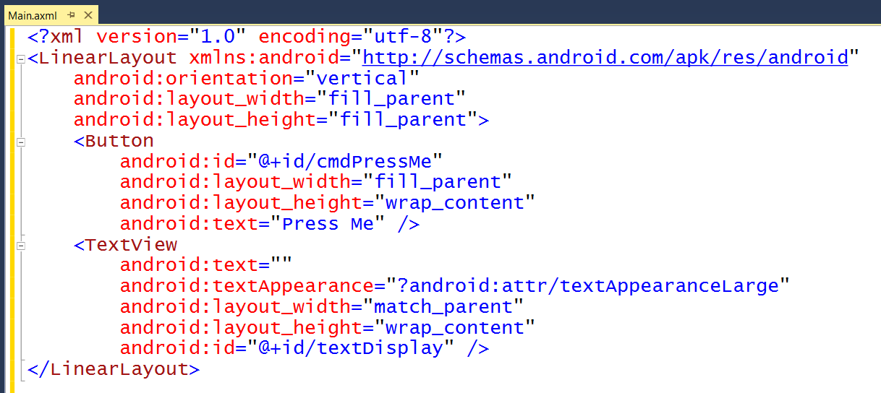
Android Layouts
UI layout decoupled from UI management code
UI Layouts created in XML-based resource files with .axml extensions
Xamarin adds Android layout design editor into to Visual Studio

Slide 38
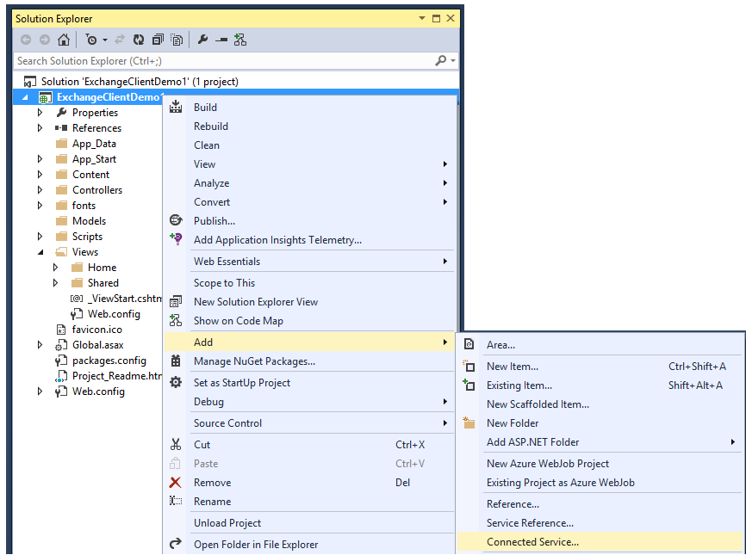
Adding Connected Services
1
Project > Add > Connected Service…
2
Register your app

Slide 39
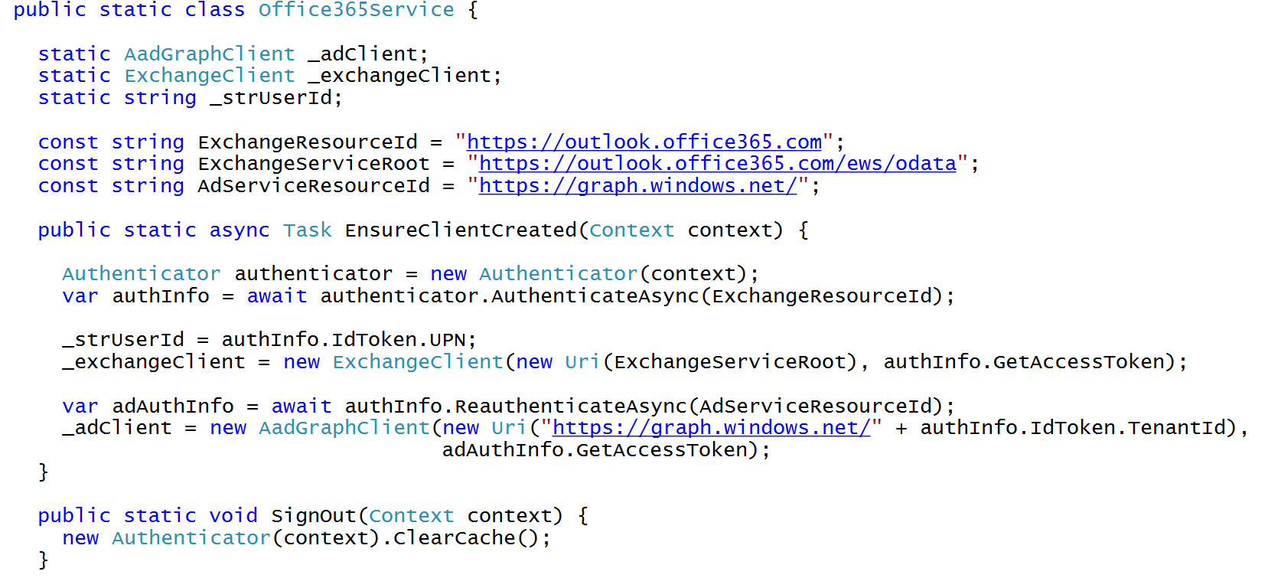
C# Code to Authenticate the User

Slide 40
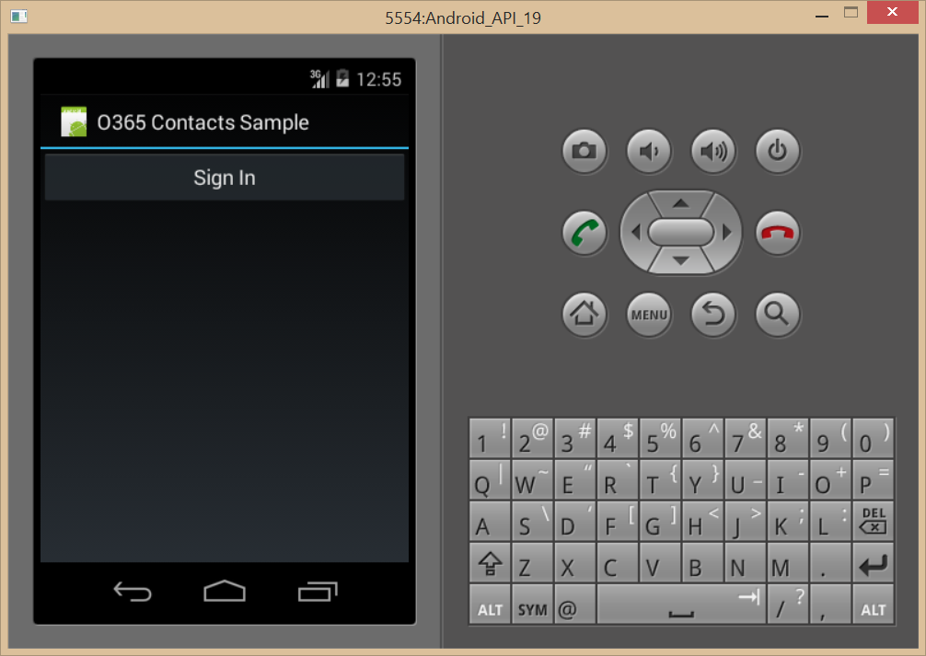
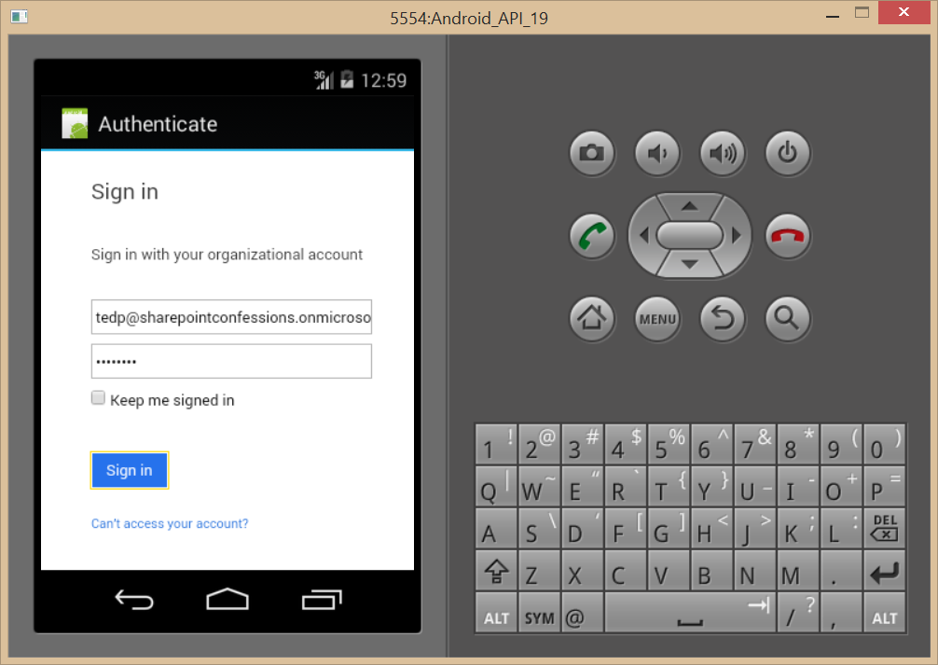
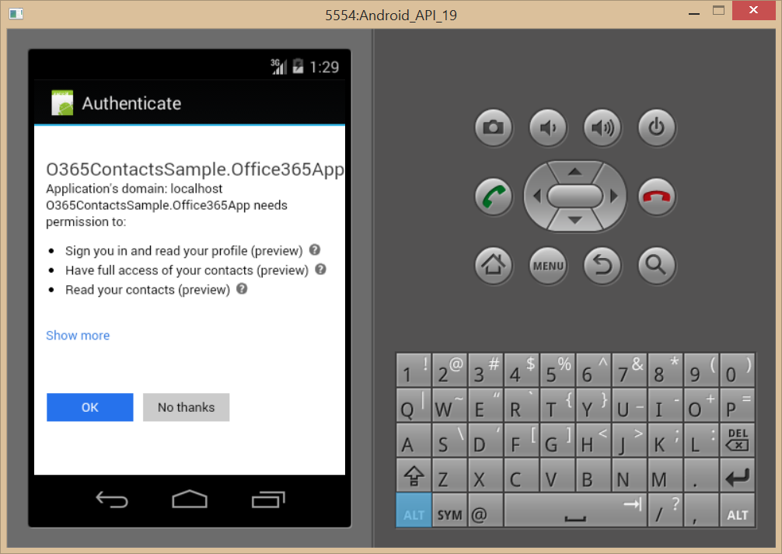
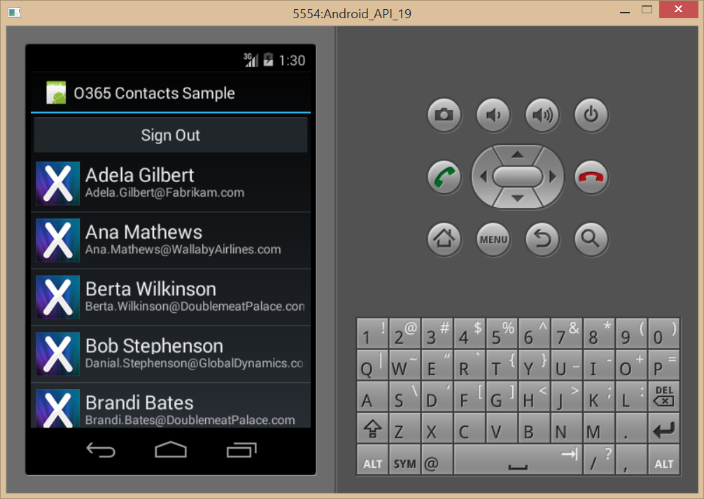
Authentication Flow

Slide 41
demo
XAMARIN

Slide 42
Summary
Intro
Windows Platform
Non-windows Platforms
Multi-platforms

